Slide 1
Web Services
Dr. Saleem Ahmed
DUET

Slide 2
What is a Web Service?
Web service is a means by which computers talk to each other over the web using HTTP and other universally supported protocols.
Web service is an application that provides a Web API.
A Web service is an application that:
Runs on a Web server
Exposes Web methods to interested callers
Listens for HTTP requests representing commands to invoke Web methods
Executes Web methods and returns the results

Slide 3
Why Web Service?
Traditional middleware doesn’t support heterogeneity
Traditional middleware doesn’t work across the Internet.
Traditional middleware isn’t pervasive.
Traditional middleware is hard to use.
Traditional middleware is expensive.
Traditional middleware maintenance costs are outrageous.
Traditional middleware connections are hard to reuse.
Traditional middleware connections are fragile

Slide 4
Web Services is based on:
HTTP (Hypertext Transport Protocol)
SOAP (Simple Object Access Protocol)
UDDI (Universal Description, Discovery and Integration)
WS-POLICY (Web Services Policy)

Slide 5
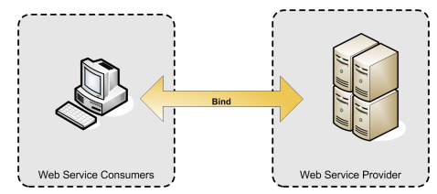
Web Service Architecture
The simplest Web service system:
Two Participants
- A service producer (provider)
- A service consumer (requester).
The provider presents the interface and implementation of the service, and the requester uses the Web service.

Slide 6
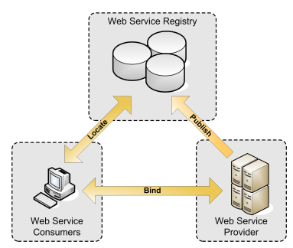
Web Service Architecture
Service Oriented Architecture
More suitable and better solution
A registry : broker for Web services
A provider : publish services to the registry
A consumer : discover services in the registry

Slide 7
Web Services Description Language (WSDL)
WSDL is an XML format for describing all the information needed to invoke and communicate with a Web Service.
A service description has two major components:
Functional Description
  How the Web Service is invoked, where it’s invoked.
  Syntax of the message and how to configure the network protocols to deliver the message.
Nonfunctional Description
  Details about secondary to the message (such as security policy)
  Instruct the requestor’s runtime environment to include additional SOAP headers

Slide 8
WSDL
6 basic building blocks
Services can be defined using below XML elements:
Types, think Data Type
Port, think URL
Service, many URLs
Message, think Methods
Binding, think Encoding Scheme
PortType, think Interfaces

Slide 9
Web service - example
package ws;
import javax.jws.WebService;
public class Add2Int {
public int add(int a, int b) {
return (a+b);
}
}
import javax.swing.*;
import java.awt.*;
import java.awt.event.*;
public class Calculator extends JFrame implements FocusListener {
JTextField value1 = new JTextField("", 7);
JLabel plus = new JLabel("+");
JTextField value2 = new JTextField("",6);
JLabel equals = new JLabel("=");
JTextField sum = new JTextField("", 9);

Slide 10
Web service - example
public Calculator() {
super("The Calculator");
setSize(220,82);
setDefaultCloseOperation(JFrame.EXIT_ON_CLOSE);
FlowLayout flow = new FlowLayout(FlowLayout.CENTER);
setLayout(flow);
// add the listners
value1.addFocusListener(this);
value2.addFocusListener(this);
sum.setEditable(true); // set up sum field
//add componets
add(value1);
add(plus);
add(value2);
add(equals);
add(sum);
setVisible(true);
}

Slide 11
Web service - example
  public void focusGained(FocusEvent event){
  try { // Call Web Service Operation
  ws.Add2IntService service = new ws.Add2IntService();
  ws.Add2Int port = service.getAdd2IntPort();
  // TODO initialize WS operation arguments here
  int result = 0;
  int result2 = 0;
  result = Integer.parseInt(value1.getText());
  result2 = Integer.parseInt(value2.getText());
  int total = port.add(result, result2);
  sum.setText("" +total);
  //float plusTotal = Float.parseFloat(value1.getText()) +
  Float.parseFloat(value2.getText());
  } catch (Exception ex) {
  // TODO handle custom exceptions here
  //value1.setText("0");
  //value2.setText("0");
  //sum.setText("0");
  }
  }

Slide 12
Web service - example
  public void focusLost(FocusEvent event){
  focusGained(event);
  }
  public static void main(String[] args) {
  // TODO code application logic here
  Calculator frame = new Calculator();
  }
  }

